Slide 1
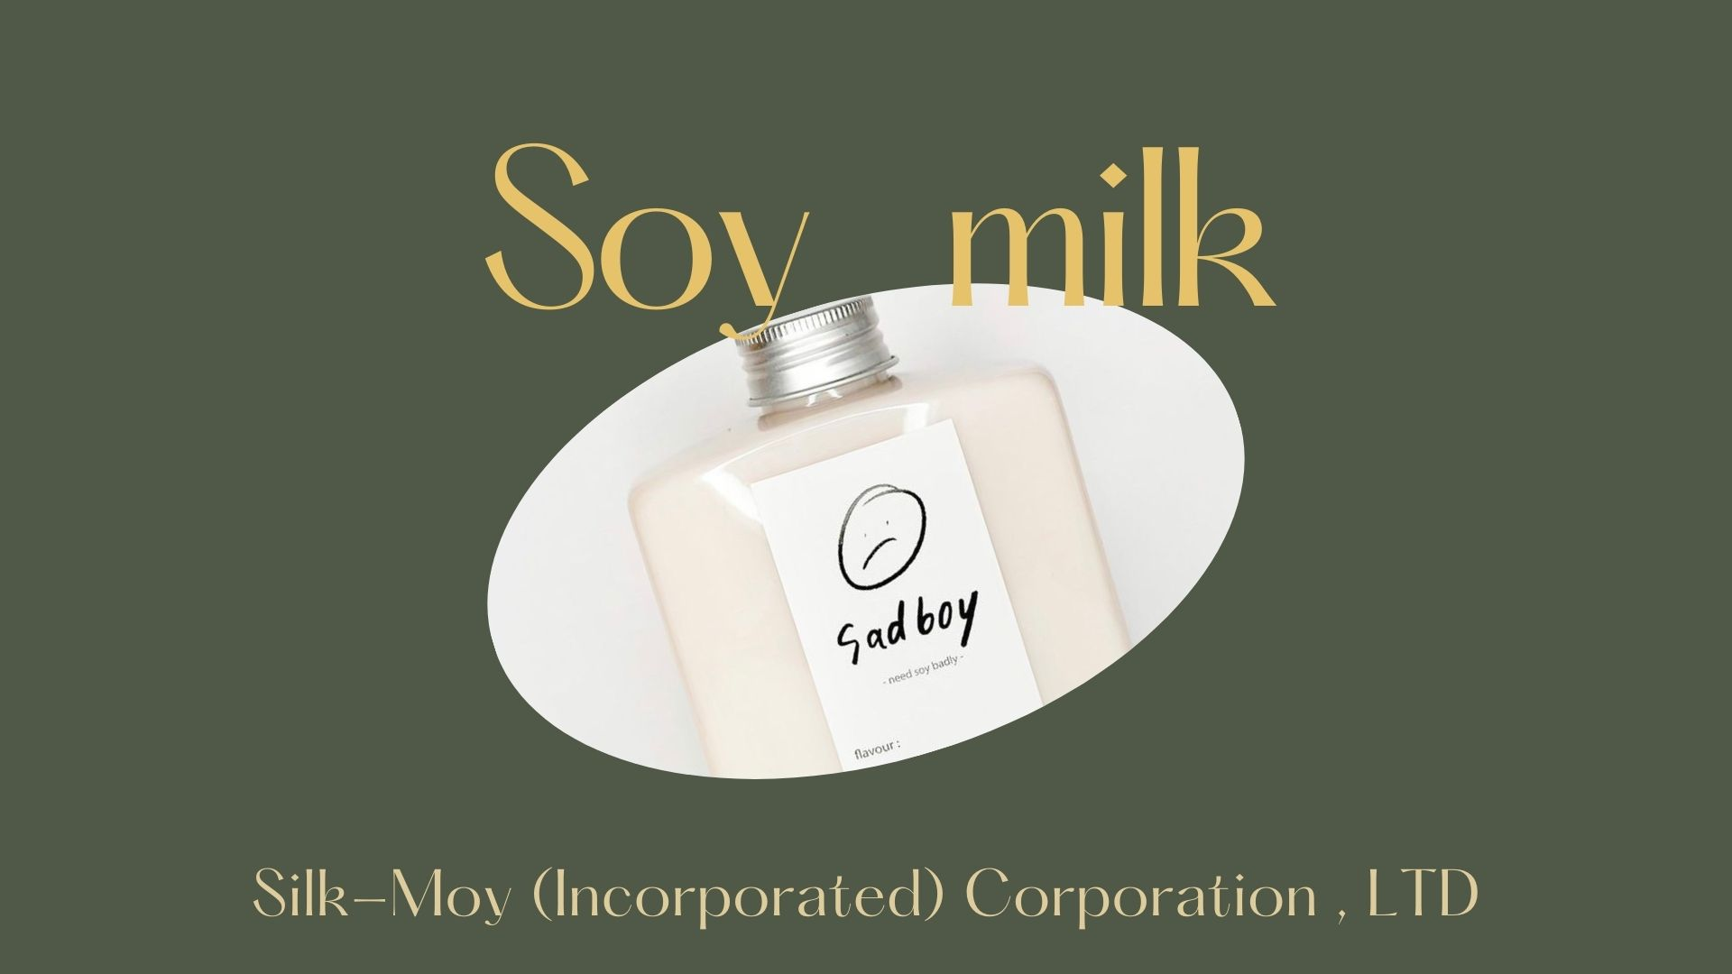

Slide 2

Members
SEC 101
Soy milk
Soy milk
63010616
63010492
Punnawich Panichphol
63010665
Napasorn Chalanumas
Phanchita Teraphatanaroj
63010484
63010702
Nonthicha Sukcharoen
Peerapat Sattapornnara
63010719
Fikaew Chayawattana

Slide 3

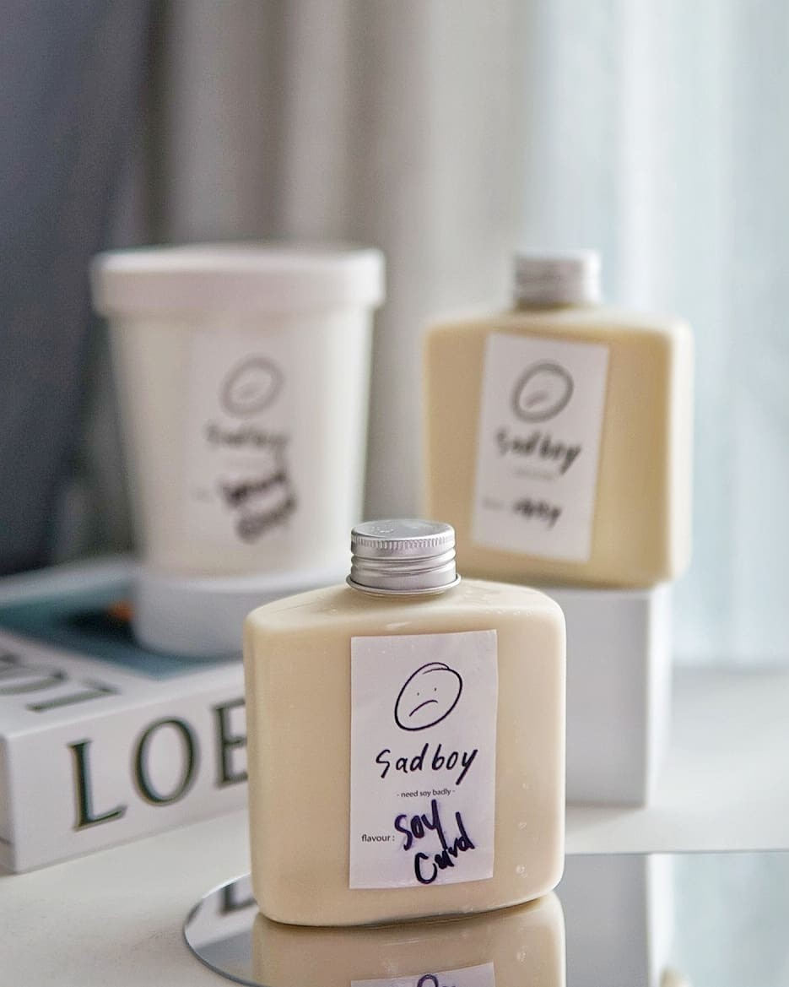
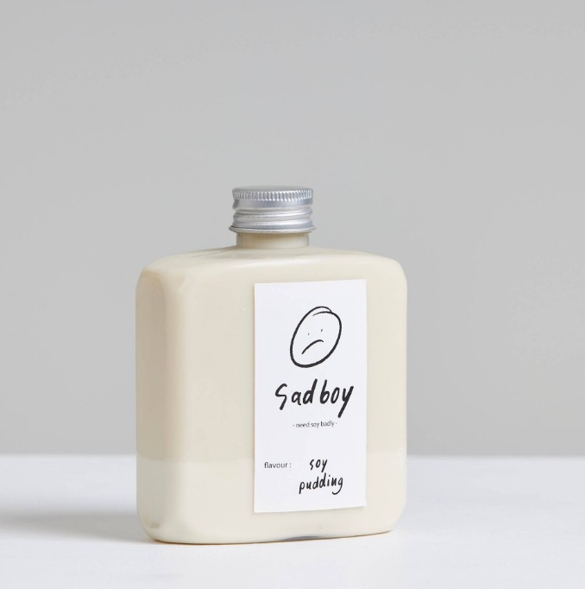
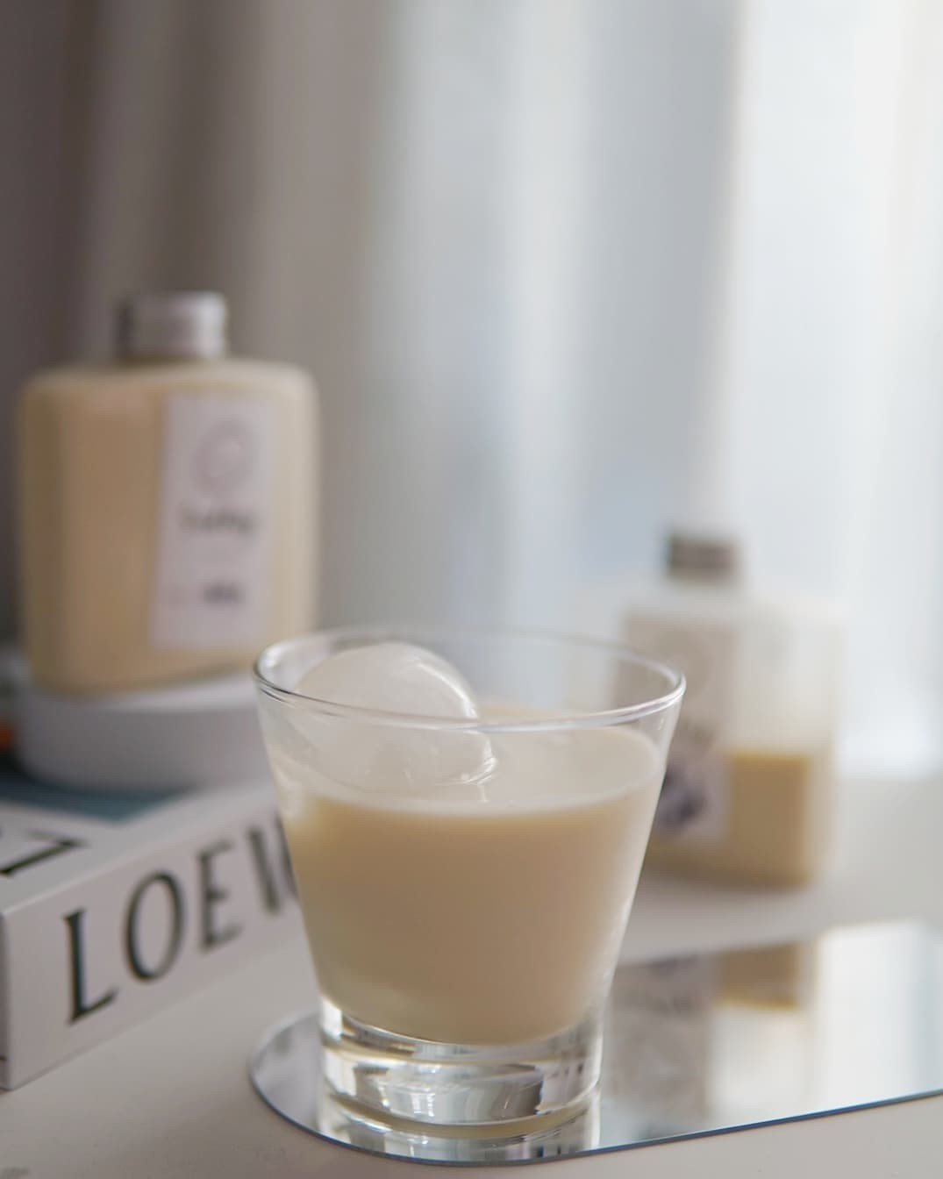
Soy milk
Business and industry
Silk-Moy (Incorporated) Corporation , LTD
Silk-Moy (Incorporated) Corporation , LTD
Reasons of choosing this type of business
The importance of safety
workplace environment
Purpose and outline

Slide 4



Why kind of
accident that
could happen?
How could it happen?
What could happen to the people involved?​

Slide 5

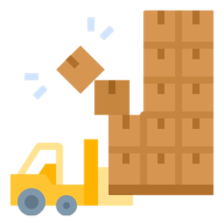

1. Accident with transportation and stock

Slide 6


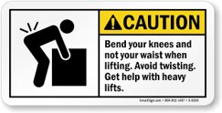
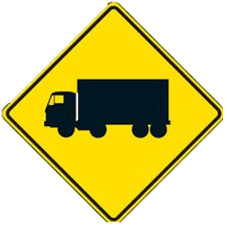
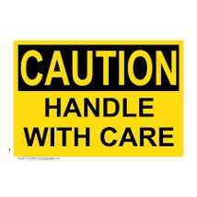
Transportation and stock caution stock
2020 Marketing Agenda
Halerdon Real Estate

Slide 7
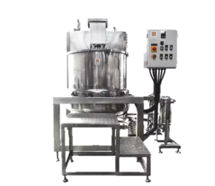
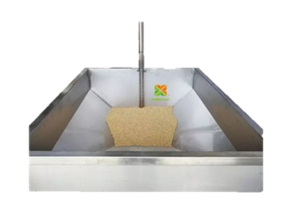
2. Accident with
defective machinery

Slide 8


Hand entanglement Rotating gear
2020 Marketing Agenda
Halerdon Real Estate

Slide 9


3. Accidents in the
production process​

Slide 10



Slip - Trip hazard label
2020 Marketing Agenda
Halerdon Real Estate

Slide 11

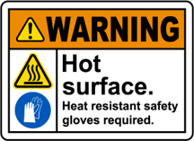
Hot surface and Safely gloves required​
2020 Marketing Agenda
Halerdon Real Estate

Slide 12
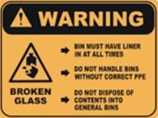
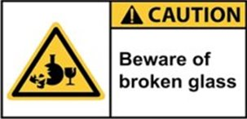
Broken glass caution​
2020 Marketing Agenda
Halerdon Real Estate

Slide 13
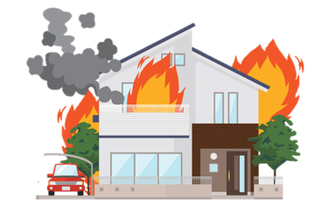

4. Fire Accident

Slide 14




Electric hazard
Fire hazard
2020 Marketing Agenda
Halerdon Real Estate

Slide 15

SAFETY
INSTRUCTIONS
for an equipment or a tool
Silk-Moy (Incorporated) Corporation , LTD
Silk-Moy (Incorporated) Corporation , LTD

Slide 16



Accident with transportation and stock
Always check the condition of the car before shipping
Turned on the alarm, While driving in the factory​
Safety
Instructions
for an equipment or a tool

Slide 17

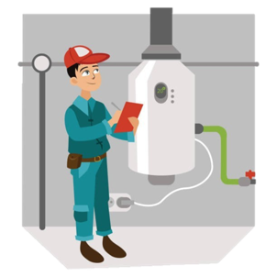

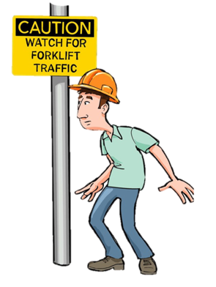
Accident with defective machinery
Always check the condition of the machine to be in good condition
When inspecting or repairing machines, always put on warning signs

Slide 18




Accidents in the production process
Follow instructions of machinery
Wearing the right equipments and clothes in each production process​
Wear hairnet to Prevent hair
from sticking to machines​

Slide 19
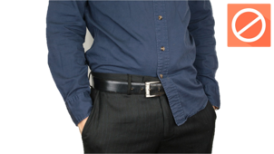
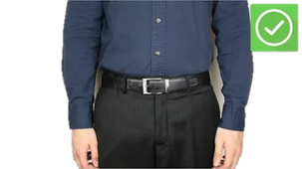
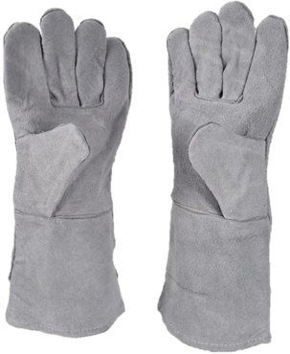
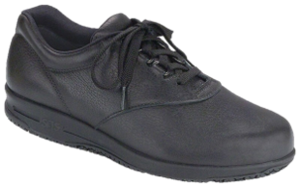
Wear tight-fitting clothing that doesn't release the hem
Accidents in the production process
Always wear gloves to prevent burning from high temperature machine​​
Wear non-slip shoes
because during the production process,
water will emanate from the machine

Slide 20
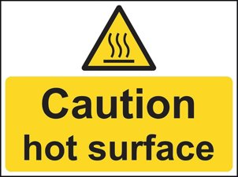
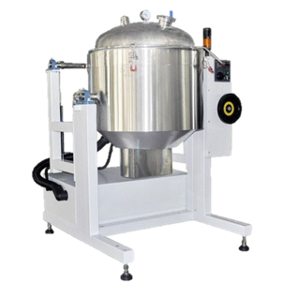
Accidents in the production process
Wait for the boiling soy pot to cool down
before handling it
Always Clean the machine and tool then return it to
it's proper storage place, After using a tool

Slide 21

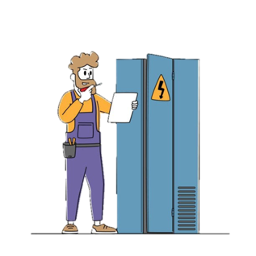
Fire Accident
Always check the electrical system
to prevent short circuit

Slide 22
SAFETY
PRECAUTIONS
Silk-Moy (Incorporated) Corporation , LTD
Silk-Moy (Incorporated) Corporation , LTD

Slide 23
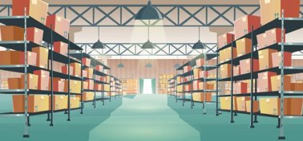
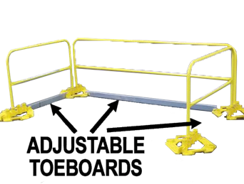
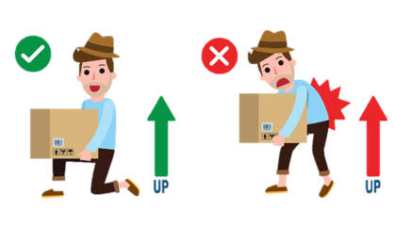
Accident with transportation and stock
Prevent Objects from Falling
Gesture of picking up​
Safety
Precautions

Slide 24

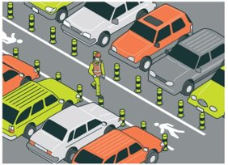
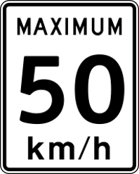

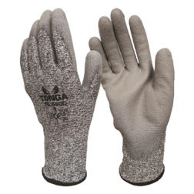
Accident with transportation and stock
Keeping vehicles and pedestrians separate
Keeping speeds low
Reversing alarms and bright paintwork
Do not pick up broken glass
with bare or unprotected hands

Slide 25



Accident with defective machinery
Use machinery only if you’re authorized, trained, and alert
Obey all operating instructions​
If something is wrong, stop the machine immediately and get assistance

Slide 26
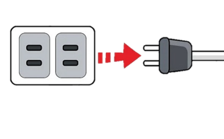

Accident with defective machinery
Always turn off the machine before cleaning
Regularly check the condition of the machine​

Slide 27
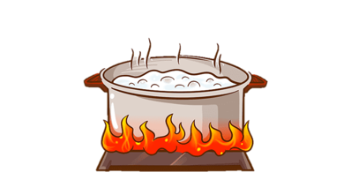
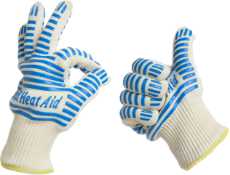
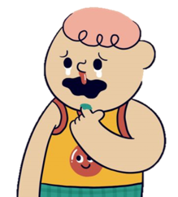
Clean your tools by waiting for the boiler to cool down before cleaning​
Accidents in the production process
Wear heat-resistant gloves at all times while working
Do not insert your fingers while the machine is moving

Slide 28
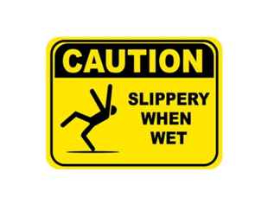
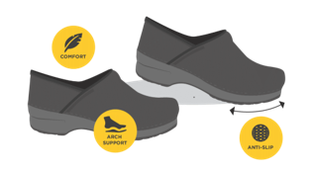

Put up a warning sign for slippery areas
Accidents in the production process
Wear non-skid footgear
Clean wet areas regularly

Slide 29
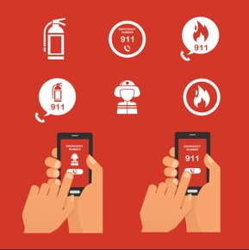

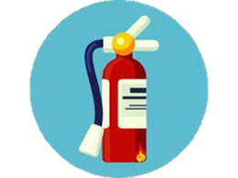
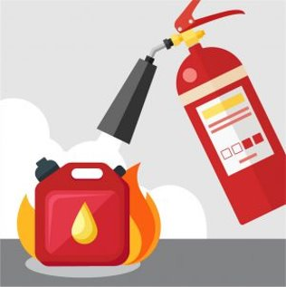
Immediately notify others
Fire Accident
Be conscious
Fire extinguishers must be available and readily attainable

Slide 30

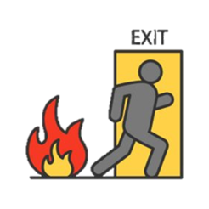
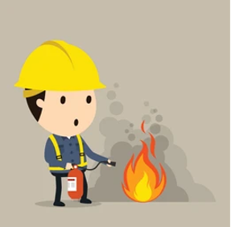
Practice fire drills
Fire Accident
Come up with a fire emergency plan to ensure that everyone knows and understands it

Slide 31
SAFETY
PROCEDURES
Silk-Moy (Incorporated) Corporation , LTD
Silk-Moy (Incorporated) Corporation , LTD

Slide 32





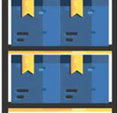
Accident with transportation and stock
Don’t load goods that exceed the weight of the truck
Safety
Procedures
Place the product in a safe place where it won't fall or damage it​

Slide 33



Drive no more than working hours as required by law
Accident with transportation and stock
Clean the car floor, prevent slipping
Check vehicle inspection or maintenance before use​

Slide 34
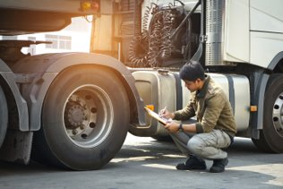
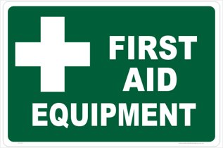
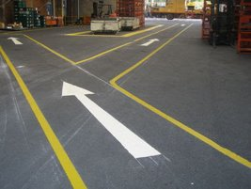
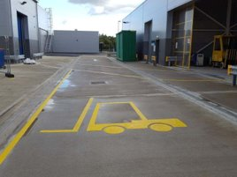
Check the stability and equipment
of the car before every use
Accident with transportation and stock
Prepare first aid equipment
and basic car safety equipment
The driver should check transportation routes

Slide 35
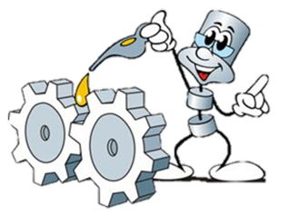
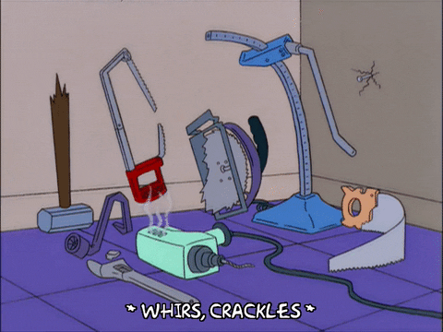
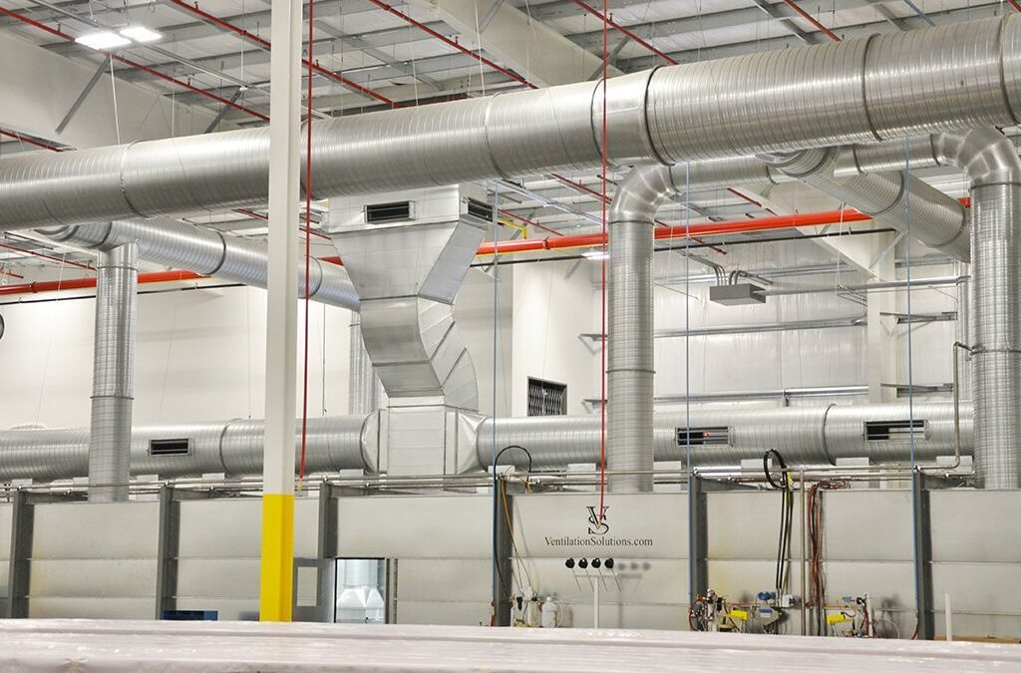


Accident with defective machinery
Training employees how to operate
the machines and maintain the machine
Ensure maintains equipment
and tools regularly
Check proper ventilation system
Check the security system

Slide 36
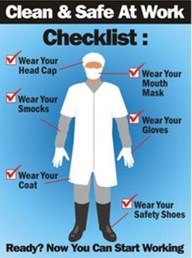
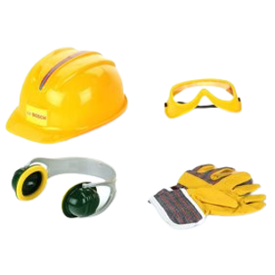
Accidents in the production process
Wear personal protective equipment
Various components and safety devices are maintained

Slide 37





Install safety equipment
Accidents in the production process
safety valves
Maintain and clean regularly
Install an emergency stop button so that the operator can stop the machine manually immediately

Slide 38



Post clear fire escape plans on every level
Fire Accident
Educate all employees on emergency procedures, exit locations, escape routes, fire alarms and drills, and the use of fire extinguishers

Slide 39



Conduct regular drills
Fire Accident
Install and properly maintain all fire safety equipment

Slide 40

What is 5S ?
Silk-Moy (Incorporated) Corporation , LTD
Silk-Moy (Incorporated) Corporation , LTD

Slide 41














SORT
SET IN ORDER​
STANDARDIZE

Slide 42








What is 5s?
SORT
Example

Slide 43

What is 5s?
SET IN ORDER
Example

Slide 44

What is 5s?
SHINE
Example

Slide 45

What is 5s?
STANDARDIZE
Example

Slide 46

What is 5s?
SUSTAIN
Example

